Slide 1
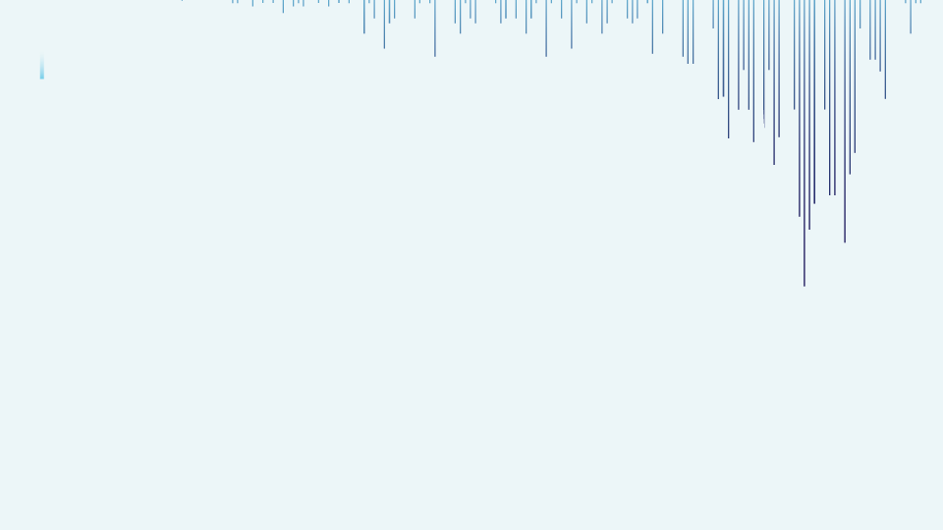

Sales Prediction and Forecasting for Walmart Stores: Exploring Feature Importance and Insights.
By LAKSHMI NARASHIMMAN D

Slide 2
Source: https://www.kaggle.com/datasets/yasserh/walmart-dataset
Problem statement:
What is the Problem?
One of the leading retail stores in the US, Walmart, would like to predict the sales and demand accurately. There are certain events and holidays which impact sales on each day. There are sales data available for 45 stores of Walmart. The business is facing a challenge due to unforeseen demands and runs out of stock some times, due to the inappropriate machine learning algorithm.

Slide 3
Source: https://www.kaggle.com/datasets/yasserh/walmart-dataset
Problem statement:
Why should we solve this problem?
An ideal ML algorithm will predict demand accurately and ingest factors like economic conditions including CPI, Unemployment Index, etc. This will help them forecast and predict the demand for 45 Walmart Stores so that it can plan its inventory, resources, budget and promotional strategies and markdowns during holiday and non-holiday weeks.

Slide 4
How my model will help:
Optimize inventory and pricing
Plan more promotional events on days with higher sales
Reduces the instances of overstocking or understocking
Efficiently allocate resources and manage the cash flows
Plan for discounts and incentives effectively
🌴 Data Analysis and Visualization on Ecommerce Dataset
This is the largest retail e-commerce orders dataset from Pakistan. It contains half a million transaction records from March 2016 to August 2018. The data was collected from various e-commerce merchants as part of a research study. Further details can be found on the following link and also download csv file from the following link

Slide 5
Issues faced in Analyzing Walmart Data
Insufficient or shortage of data
Inadequate features
No information on the US provinces
Lack of information on markdowns specifically for holiday seasons

Slide 6
Step to follow:
Importing and reading data
Data Cleaning and Preprocessing
Exploratory Data Analysis (EDA)
Feature Engineering
Model Building and Evaluation: Regression and time series
Feature Importance
Model findings and recommendations

Slide 7
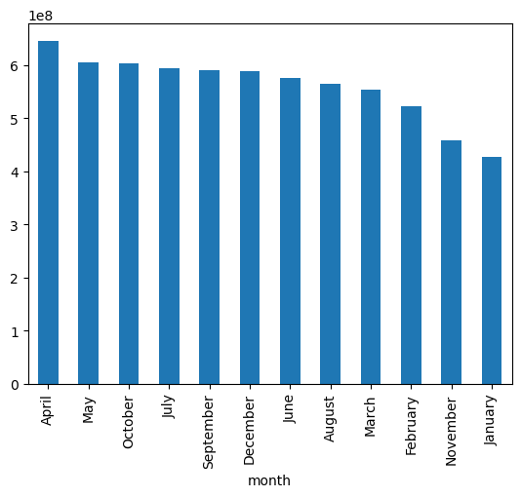
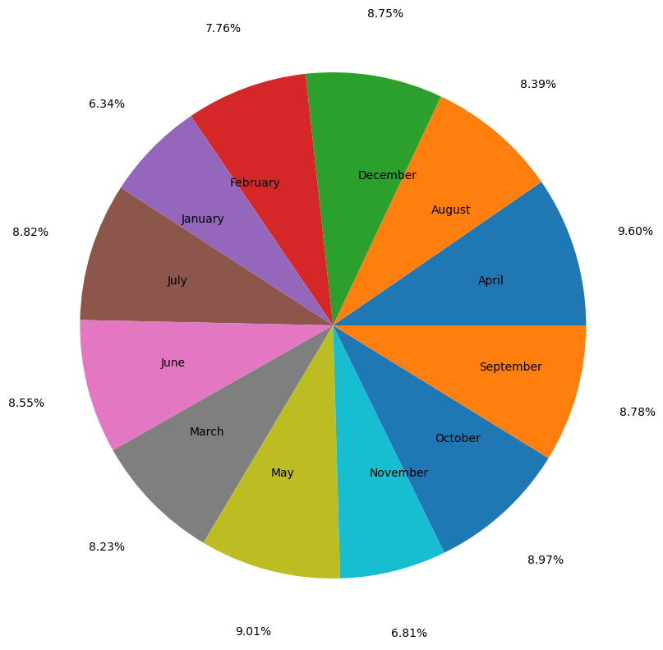
EDA : (Exploratory data analysis)
Month with the highest Sales: April

Slide 8
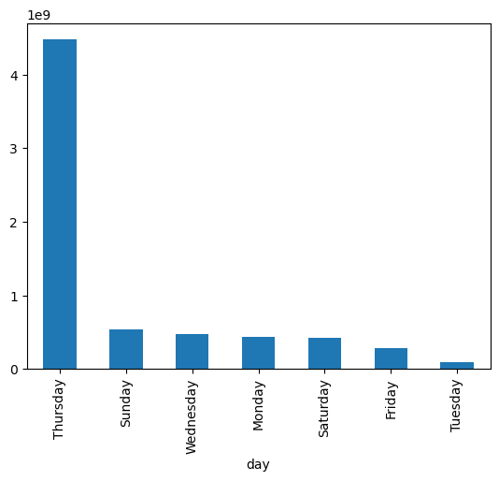
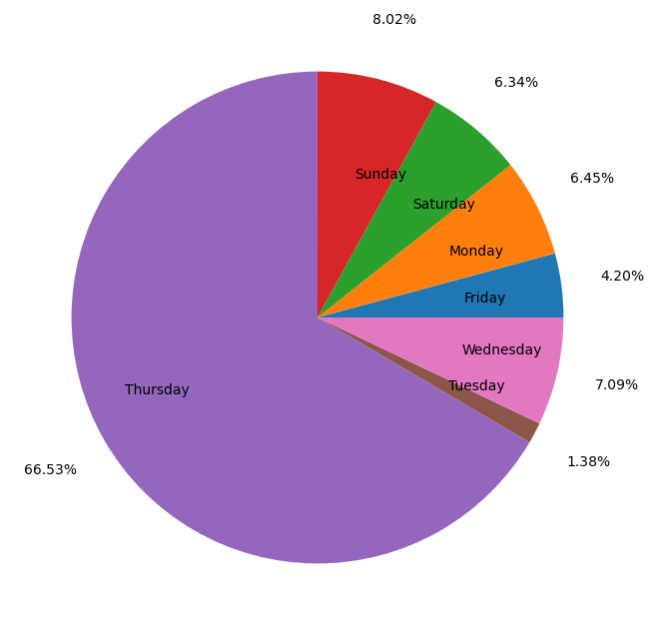
Which day had the highest sales for Walmart?
Walmart stores had the highest sales during Thursdays.

Slide 9
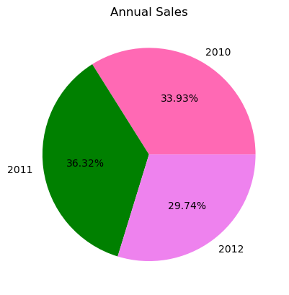
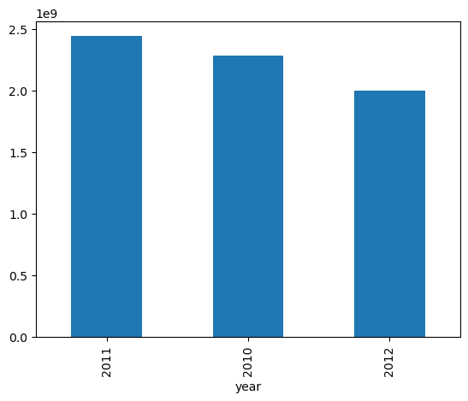
Which year contributed to highest sales?
2011 contributed to the highest Sales to Walmart

Slide 10
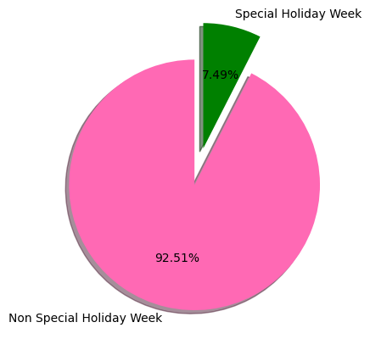
Which week had the highest sales: Holiday or Non holiday week?
The non-holiday weeks contributed to a higher sales compared to the holiday weeks.

Slide 11
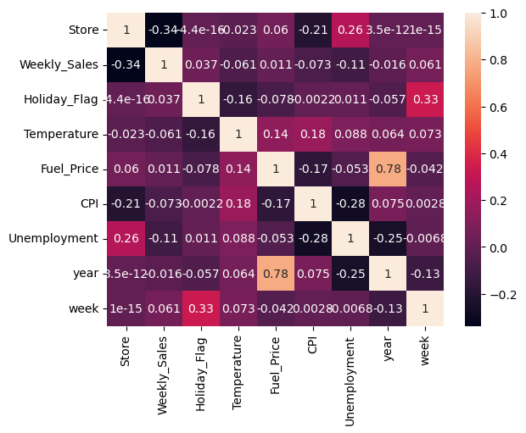
Correlation Matrix for all features
We can see that store and unemployment have some amount of correlation of 0.26
Temperature and fuel price have only 0.14 correlation
Whereas, temperature and CPI has a lesser correlation of 0.18
So, there is lesser possibility of multicollinearity from this above correlation
We don't take the year and fuel price into concern as year is a constant variable with only three unique values

Slide 12
Which Stores performed the best and least?
Top 15 Best Performing Walmart Stores | Top 15 Least Performing Walmart Stores
1. Store 20 2. Store 4 3. Store 13 4. Store 14 5. Store 2 6. Store 10 7. Store 27 8. Store 1 9. Store 6 10. Store 19 11. Store 39 12. Store 31 13. Store 23 14. Store 24 15. Store 11 | 1. Store 33 2. Store 44 3. Store 5 4. Store 36 5. Store 38 6. Store 3 7. Store 30 8. Store 37 9. Store 16 10. Store 9 11. Store 29 12. Store 42 13. Store 7 14. Store 43 15. Store 15

Slide 13
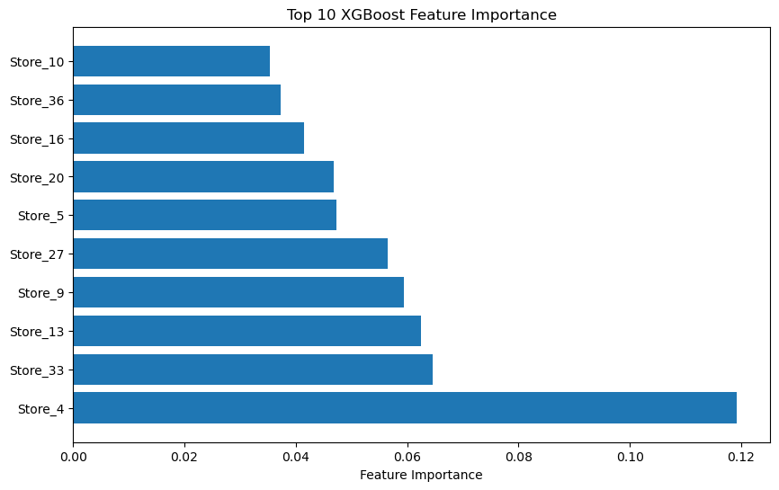
Model:
Gradient Boosting Regression: Feature Importance

Slide 14
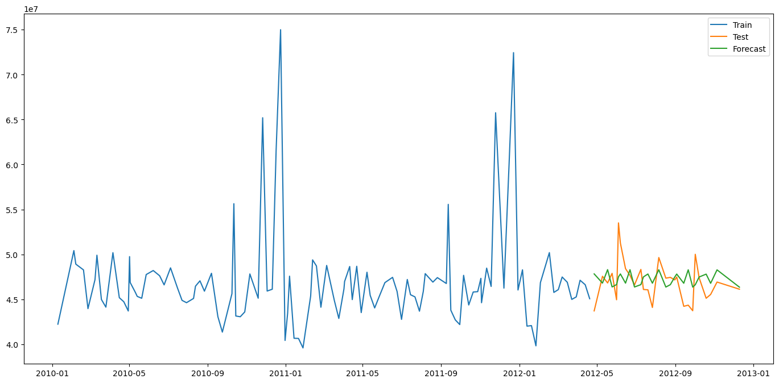
Model:
Holt Winter’s Exponential Smoothing Model:

Slide 15
Evaluation metrics: Regression Problem
Regression Models | R2 Training score | R2 Test Score | RMSE for predictions | Standard Deviation of the actual y values (test)
Linear Regression | 0.931 | 0.930 | 147695.79 | 560330.6
Random Forest Regression | 0.388 | 0.388 | 438183.79 | 560330.6
XG Boosting Regression | 0.960 | 0.958 | 114504.00 | 560330.6

Slide 16
Evaluation metrics: Time Series Forecast
Seasonal Periods | RMSE | Standard deviation for actual y values
3 | 2495047.54 | 2273486
6 | 2279930.10 | 2273486
9 | 2648762.69 | 2273486
12 | 3000303.99 | 2273486

Slide 17
Findings and Recommendations
1. As Thursday is the highest in terms of day-based sales, Thursday is the best day in the week for providing added discounts and promotions
2. With April topping in sales of all stores, April is the best month for providing any discounts or coupons. Not just during April, during July, October, and December, Walmart needs to stock items as there might be a rise in demand during these times. Also, there is a fall in Walmart sales during June, August, November and January. These are the times when the stock needs to be kept lesser as the sales might fall.
3. 41st week that is first and second week of October is the best time for any weekly discounts offered to customers. Also, Walmart needs to stock more during this time as it is the start of Holiday season sales like Single's day.
4. 2011 had the highest sales among all the three years
5. As most sales occur during the non-holiday weeks, Walmart must keep its stock reserved for these times than the holiday week

Slide 18
Findings and Recommendations
Ensure that these best performing stores doesn't run out of stock as they consistently perform on a yearly, weekly, monthly and daily basis. Also, most importantly, it is necessary to provide a basket of items for some discount to encourage sales.
These stores didn't get enough public attention or footfall traffic for transactions
So, it is better to minimize the stocks in these stores and focus on getting more transactions in this area and then maximize the stock keeping units (SKU) accordingly
Trying omnichannel sales can be another way or Walmart can change these regions into cloud stores like how it did during COVID-19 pandemic
Integrating some of these stores in the region where customers from two different areas can travel and get back to their homes quickly. So, they can utilize network optimization to place their shops near densely populated customer regions.

Slide 19

Thank you!!!

